Slide 1
Install DoD CA Certificate Instructions for IE
Accs
20180312

Slide 2
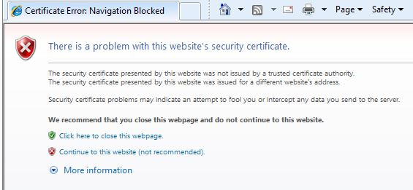
Some ACCS Users get Untrusted Certificate Warning when Visiting ACCS
These Instructions should eliminate this issue for Internet Explorer (IE) Users

Slide 3
Instruction Steps
1 – Save Certificate File
2 – Open Internet Explorer (IE)
3 – Tools → Internet Options
4 – Content Tab → Certificates Button
5 – Import → Next
6 – Filename Browse to Select Certificate → Open
7 – Next → Select Place all certificates in the following store → Click Browse to change 'Personal' to Trusted Root 'Certification Authorities' → OK → Next → Finish Note: You many get a warning to install 1 or 2 certificates, Just click yes on each of them
8 – Popup ‘Import was Successful → OK → Close
9 – Close the IE Web Browser
10 – Open the IE Web Browser and go to https://accs.army.mil (Should not get any untrusted certificate error)

Slide 4
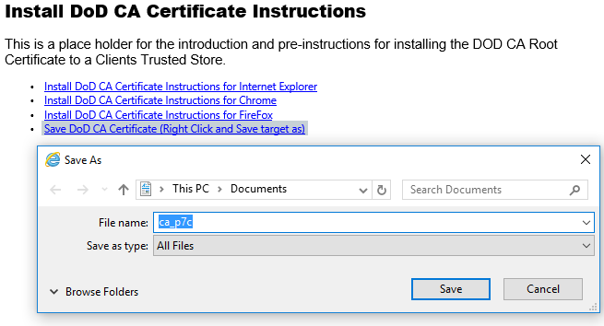
1- Save Certificate File

Slide 5


2- Open Internet Explorer (IE)

Slide 6
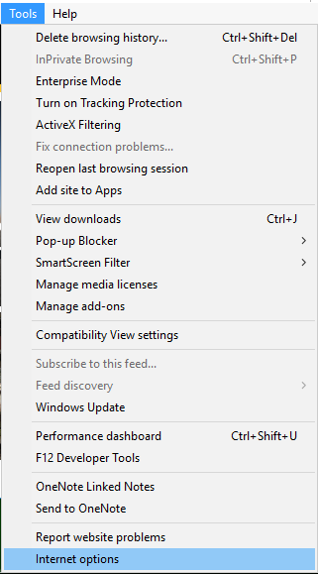
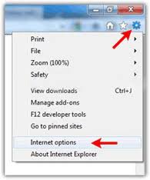
3- Tools → Internet Options

Slide 7
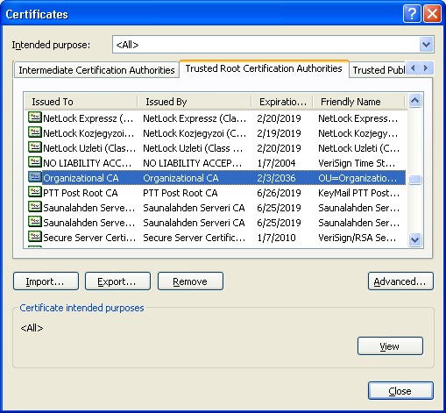
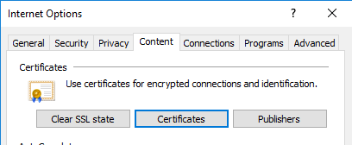
4- Content Tab→ Certificates Button

Slide 8
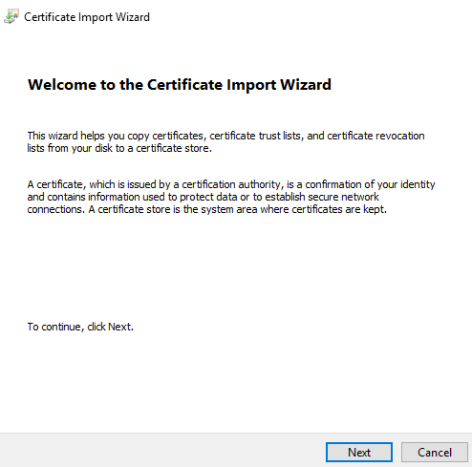
5- Import → Next

Slide 9
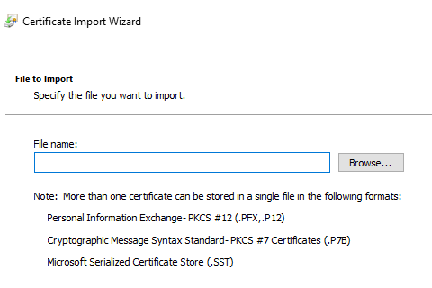
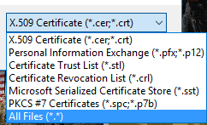
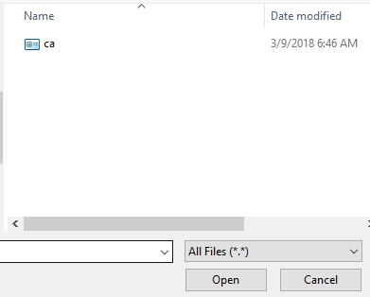
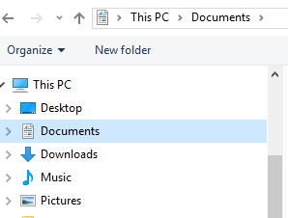
6 – Filename Browse to Select Certificate → Open

Slide 10

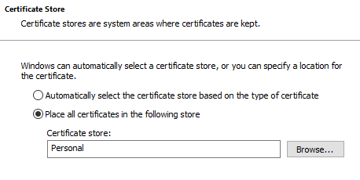

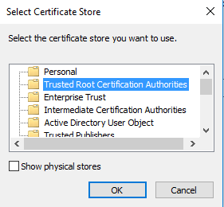

7 – Next → Select Place all certificates in the following store → Click Browse to change 'Personal' to Trusted Root 'Certification Authorities' → OK → Next → Finish

Slide 11
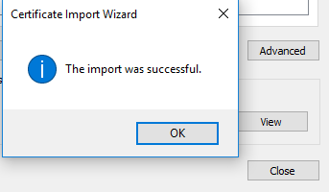

8 – Popup ‘Import was Successful → OK → Close → OK

Slide 12
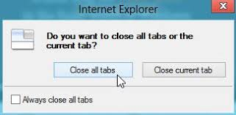

9 – Close the IE Web Browser

Slide 13
10 – Open the IE Web Browser and go to https://accs.army.mil

Slide 14

Hopefully no more Certificate Errors

